Slide 1
Fatigue Test Crack Propagation Image Analysis Fatigue Test Analysis
By Sasha Ries

Slide 2
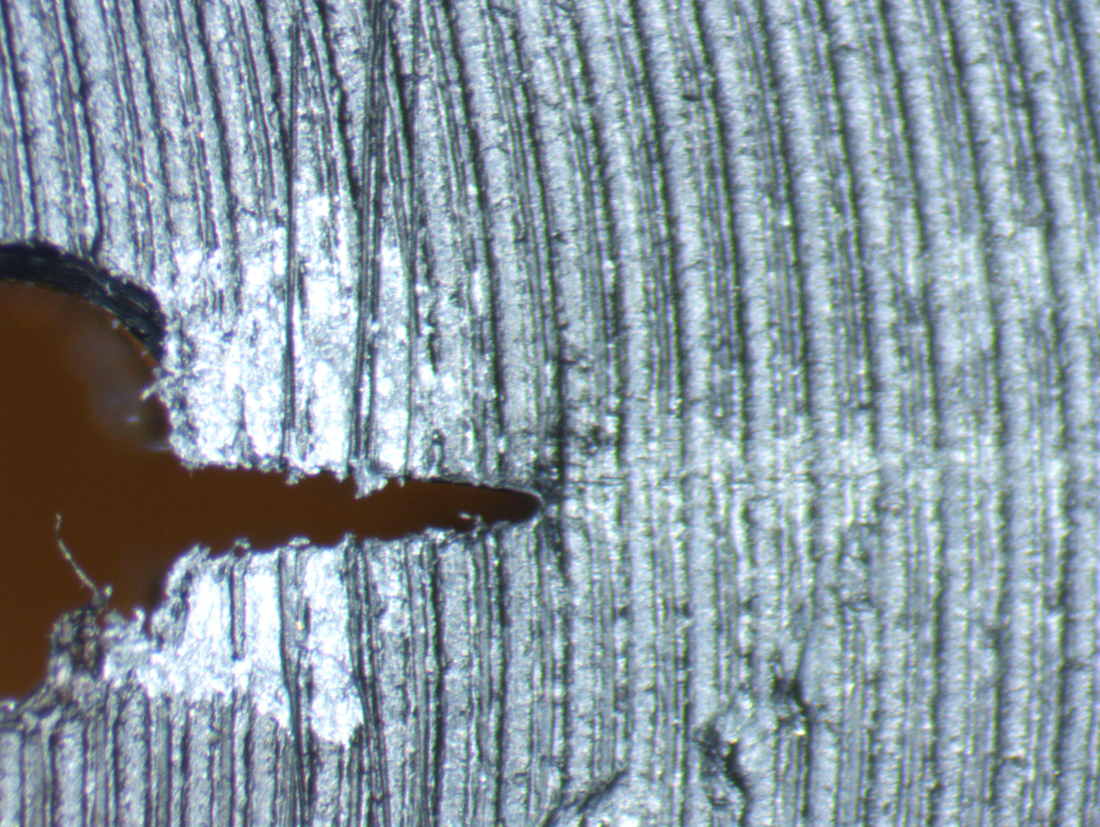

Basic Aim
Automate the process of measuring crack lengths in polymer fatigue samples
Takes a folder of labeled images and outputs an excel file of crack lengths vs number of cycles + the original images with red squares at the corners and crack tips

Slide 3
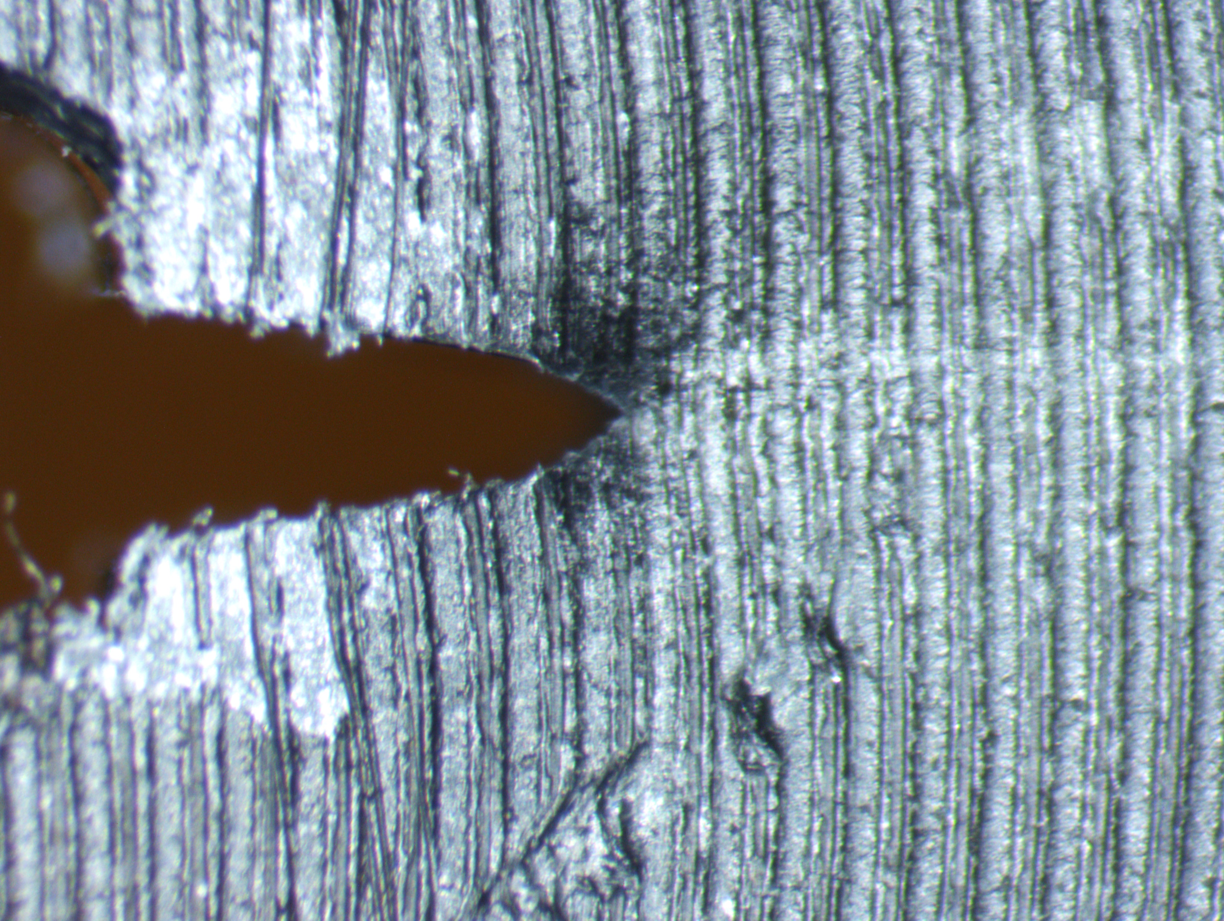
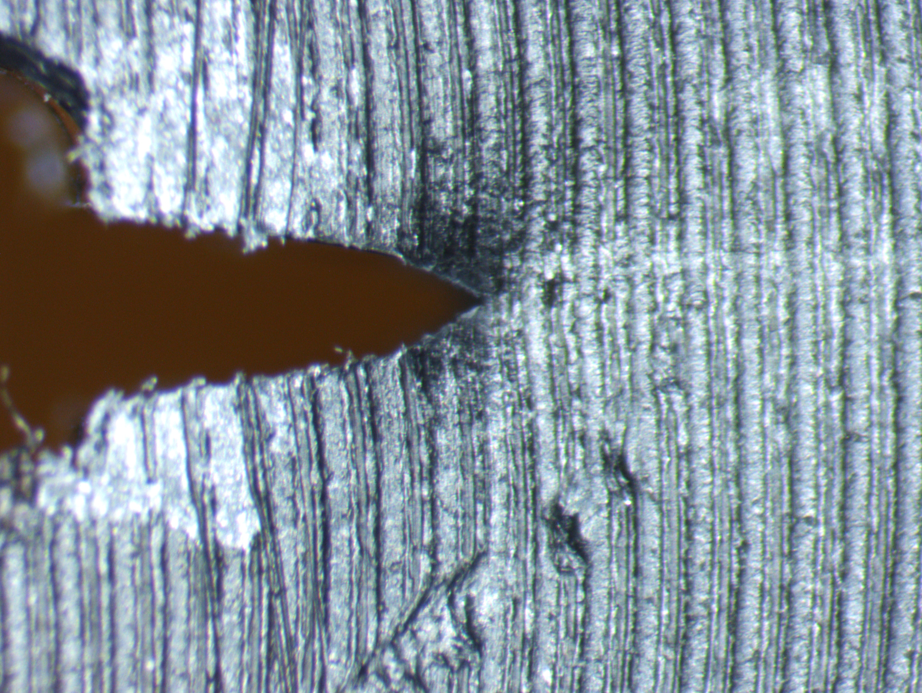
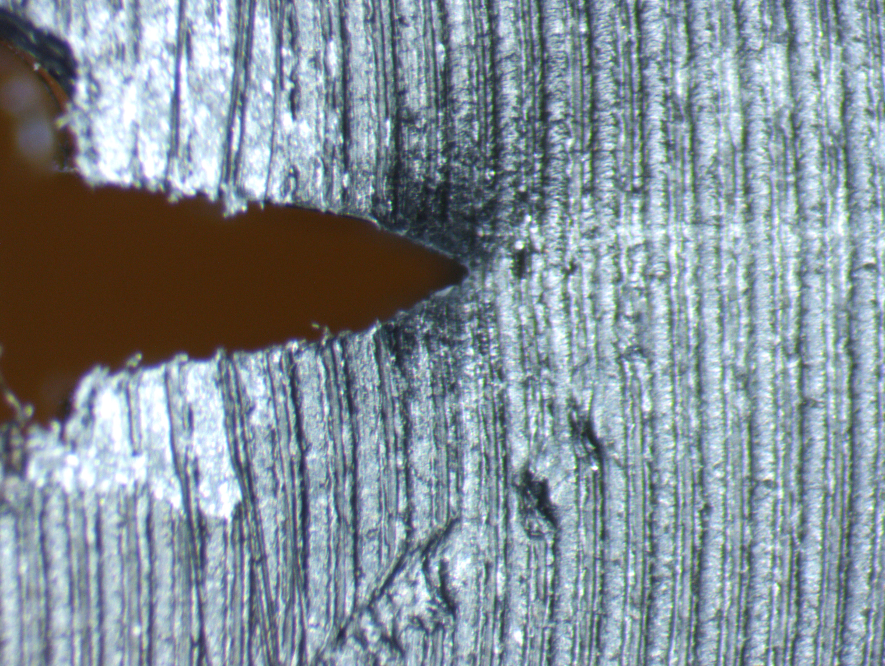
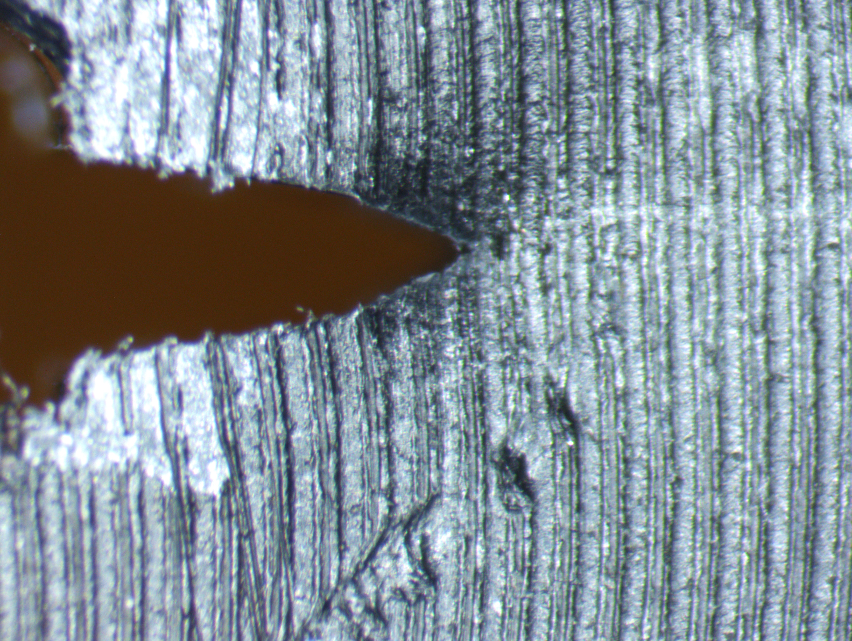
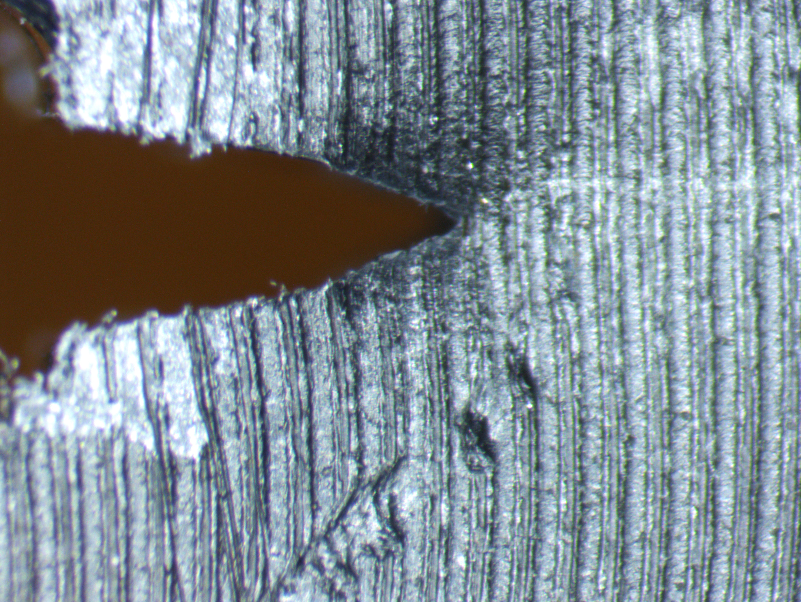
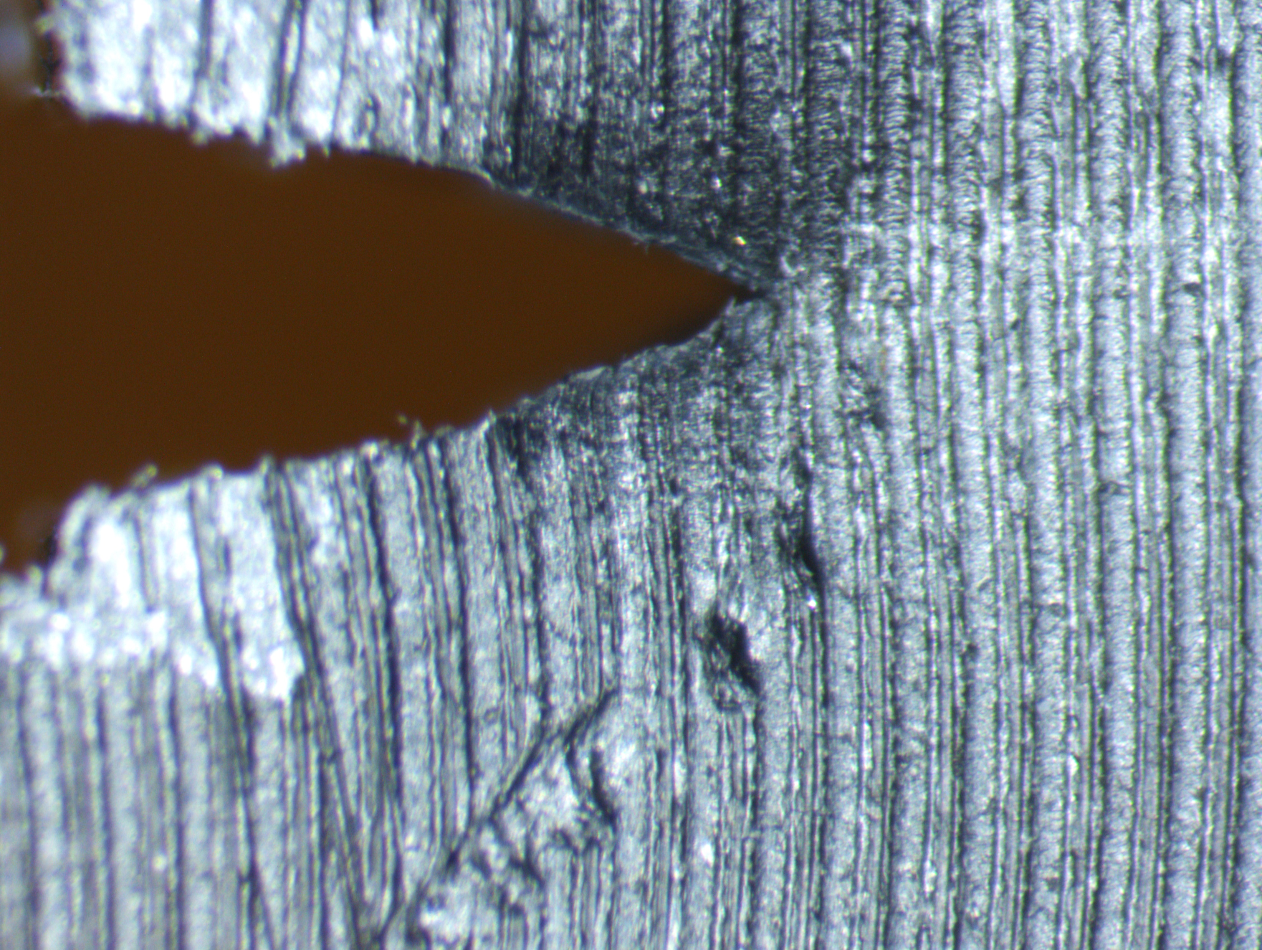
Example
-Image taken every 2000 cycles, or at certain loads every 10,000 cycles
-These images are every 2000 cycles, at min-max load 12.5-125N and last image is at 13.5-135N

Slide 4
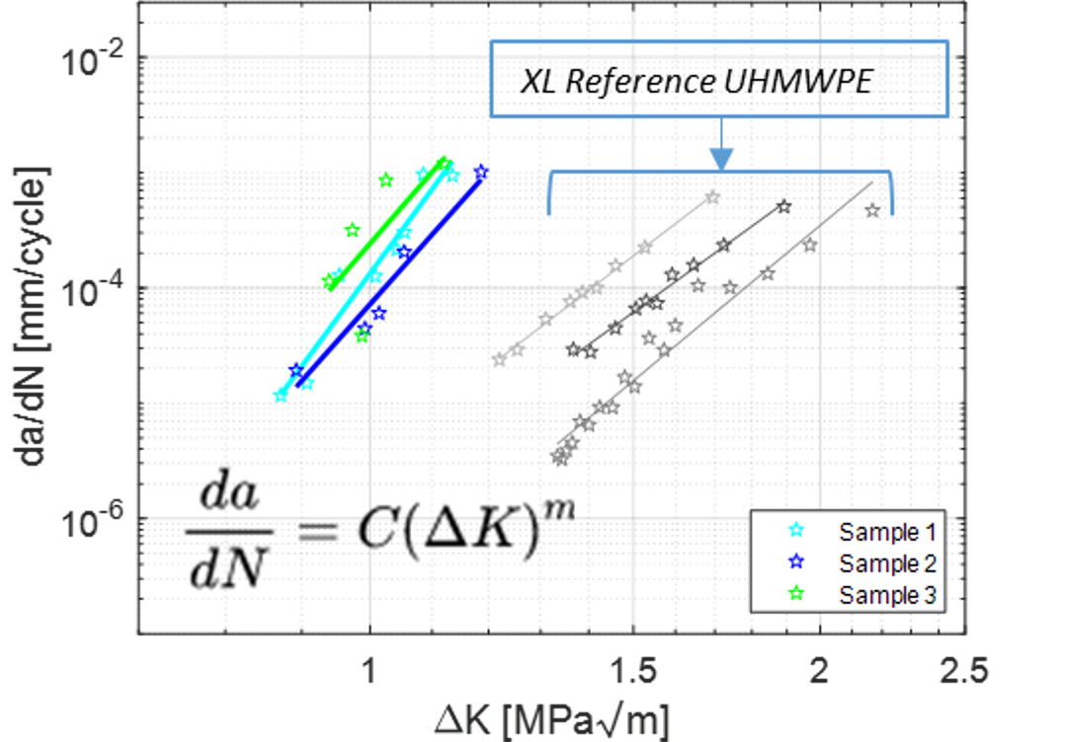
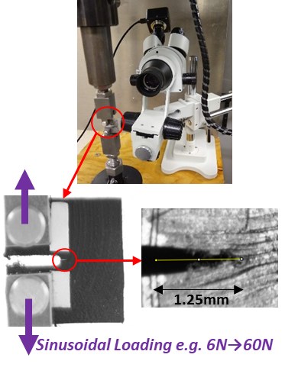
Background
Sourced from Peder Soldberg

Slide 5
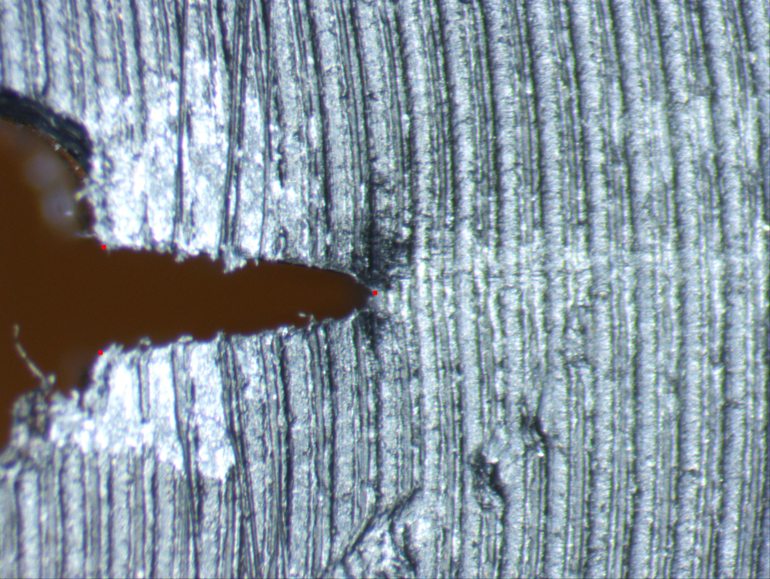
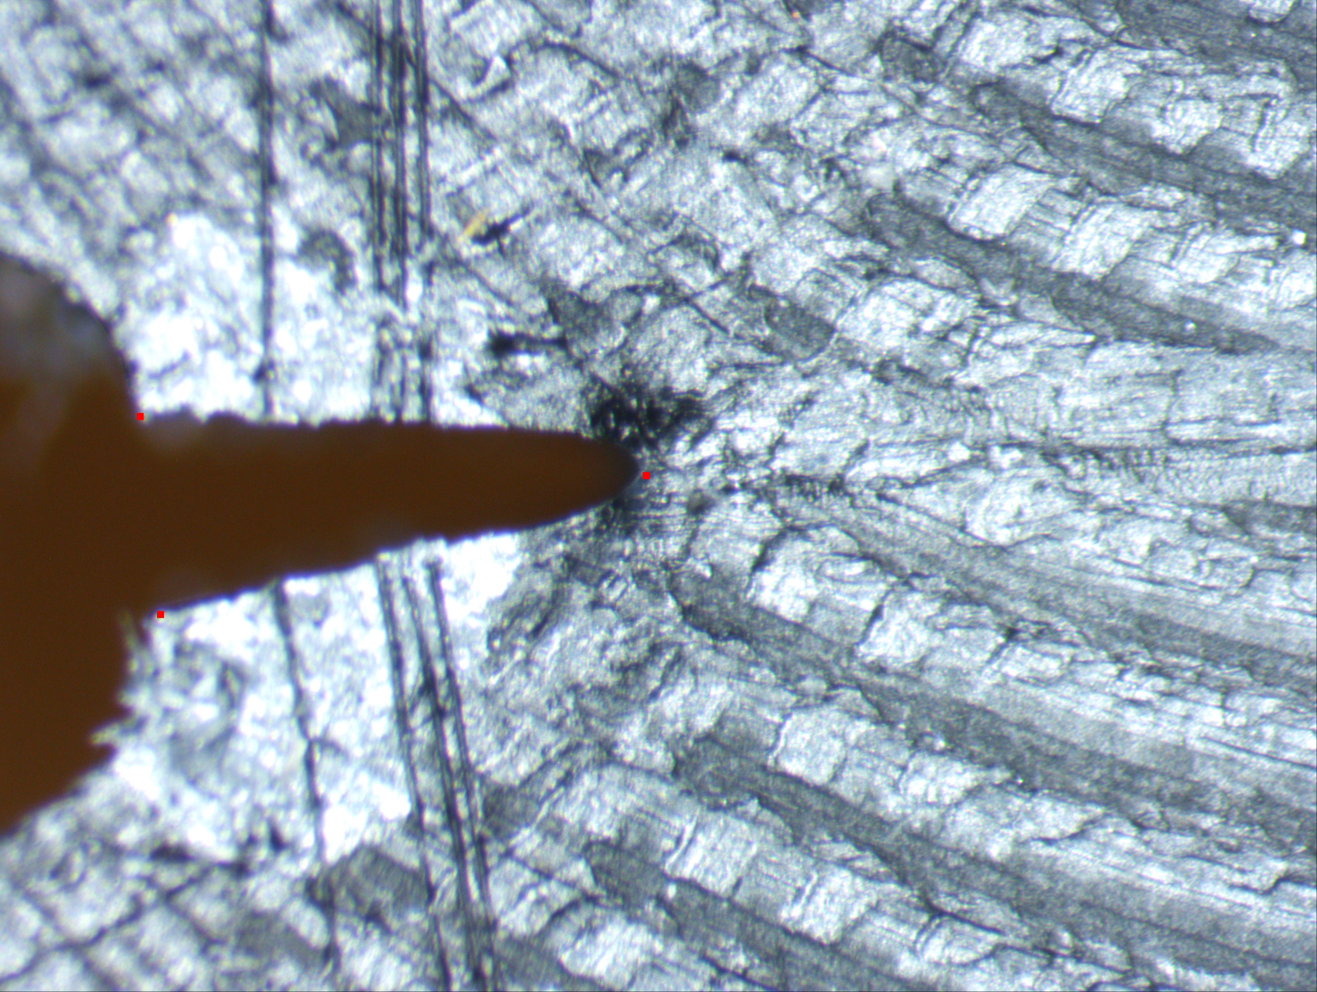
Specifications
We want accurate to within 10 pixels of crack tip and consistent within 10 pixels of corner location
Run time less than 20 minutes for 30 image folder

Slide 6
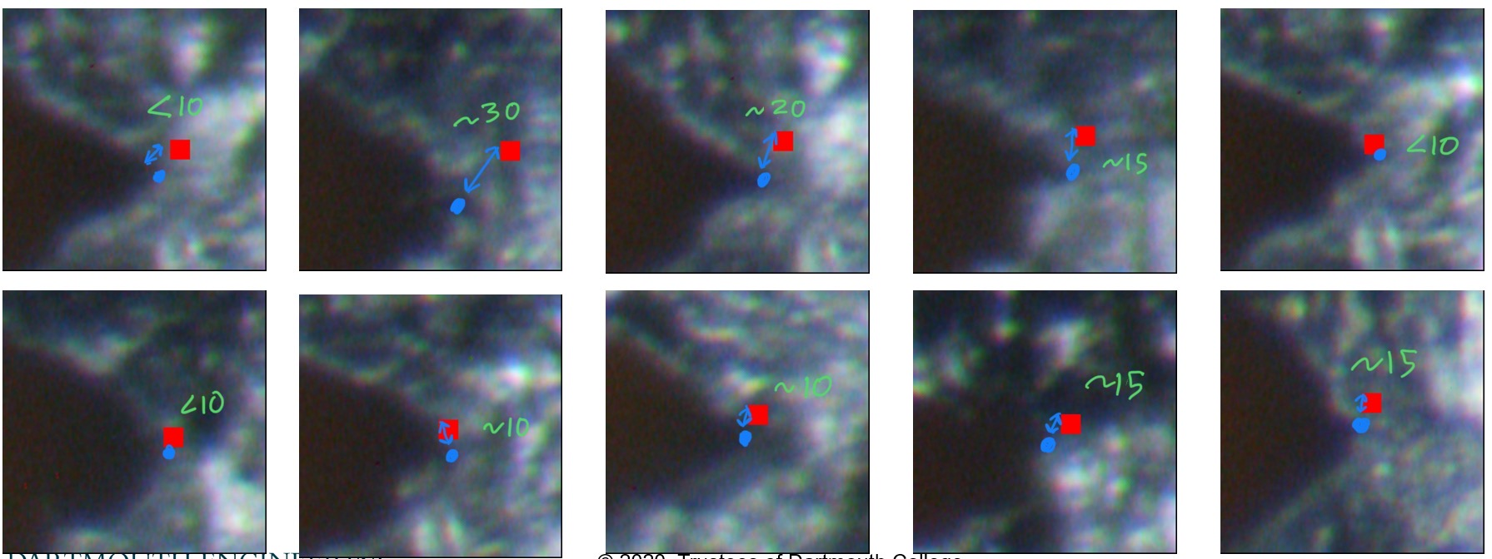
Milestones
Currently can corners within 20 pixels of accuracy (Using Python)
Currently can locate crack length within 25 pixels
c

Slide 7

Problems
Images vary a lot and can cause inaccuracy or full on failure to analyze an image
Sometimes hard to determine crack tip even for a human
Run time can exceed 2 minutes per image
Zoomed in images of different crack tips

Slide 8
Next Steps
Implement a machine learning model
Compare working classical/brute force method to machine learning model
Compare run time, accuracy, and robustness of the two

Slide 9
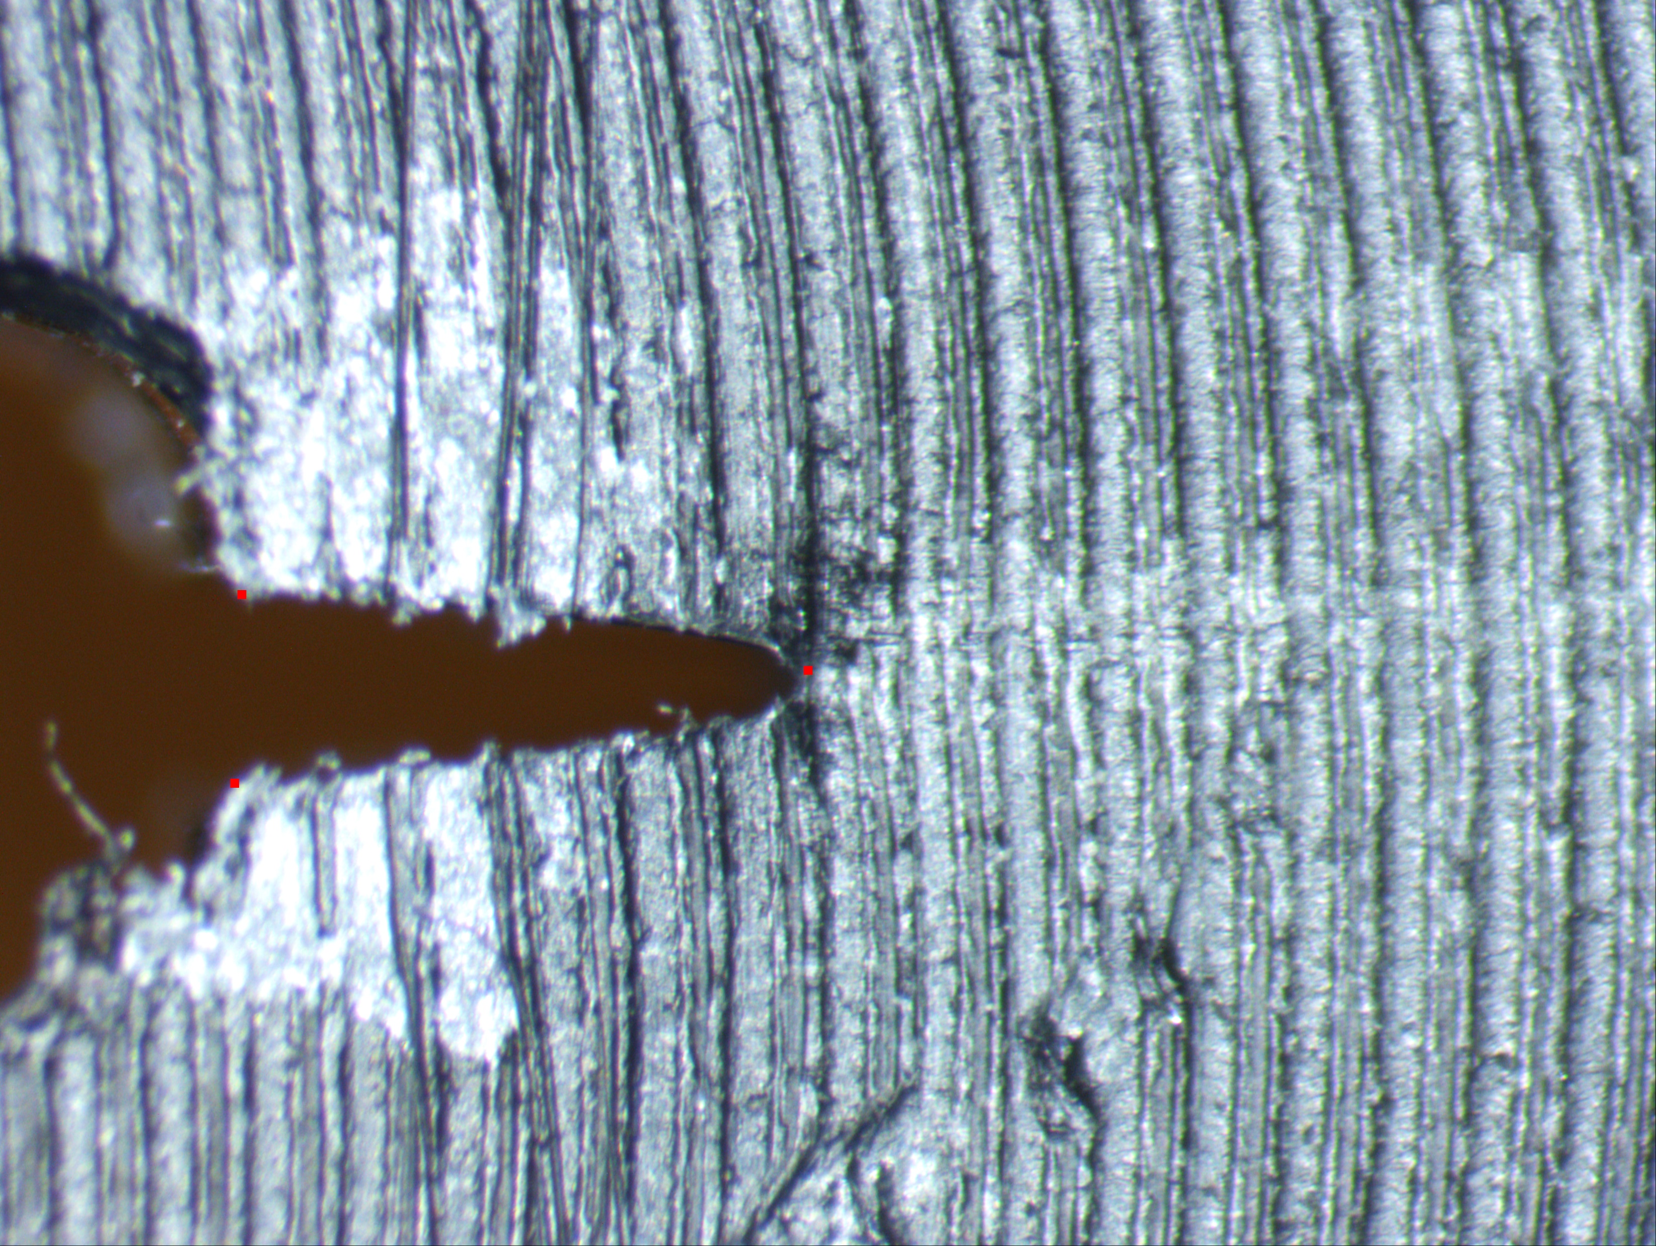
Thank you

